Slide 1

MOBILE 2
features
EVENTME APPLICATION PROJECT
teams
about
improve
NGUYEN MINH TOAN – 300282395
TRUONG THANH THAO - 300284134

Slide 2

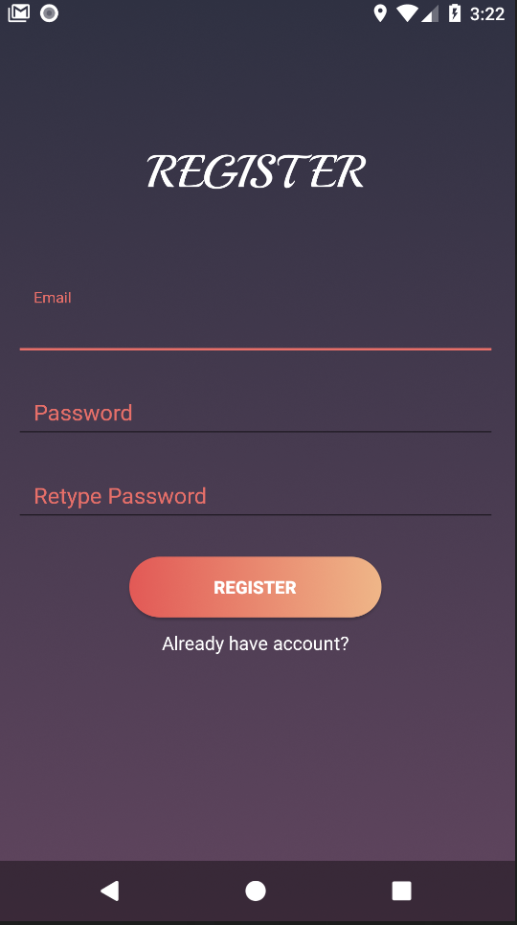
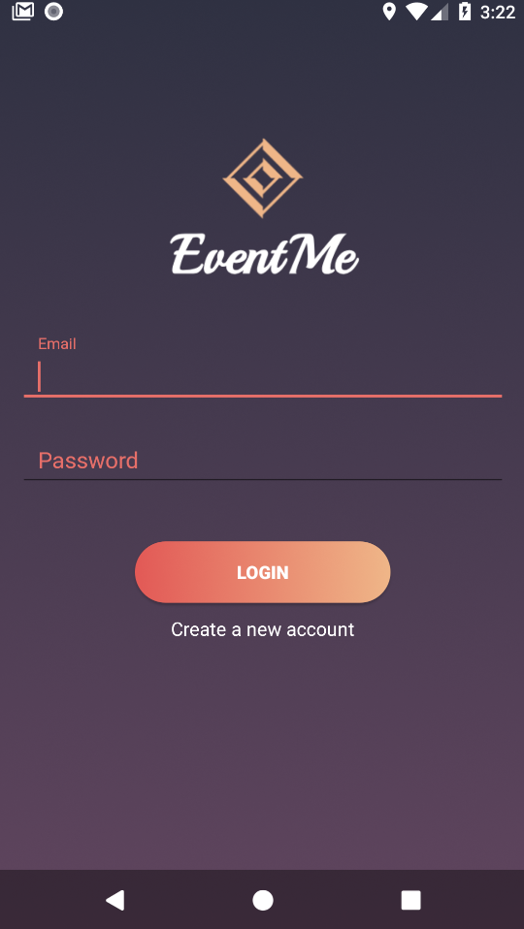
EventMe
Multi-users app
Real-time experience
Locate user’s current location and recommend nearby events
Enables users create and manage their own events
teams
features
about
improve

Slide 3
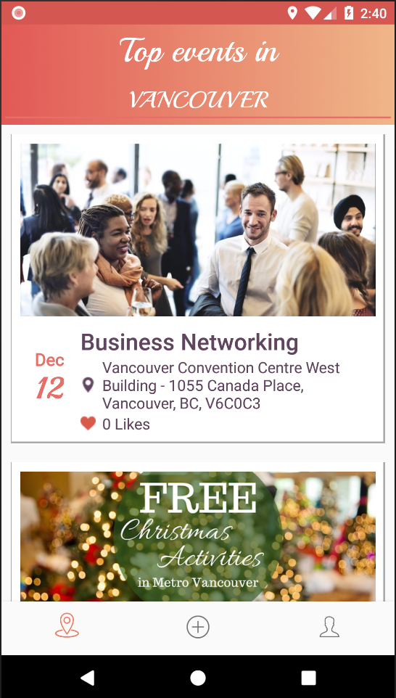
Components
Search events by location
(default: device’s location)
Dynamic Fragments
Lists View
Collapsible view
Loading Bar
Floating Action Button
Bottom Navigation
teams
General information of the events
features
improve
about
Only fetch events in the future

Slide 4
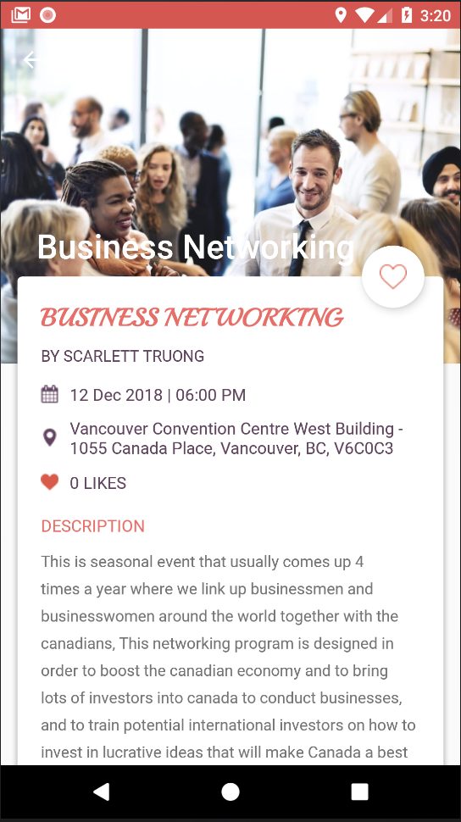
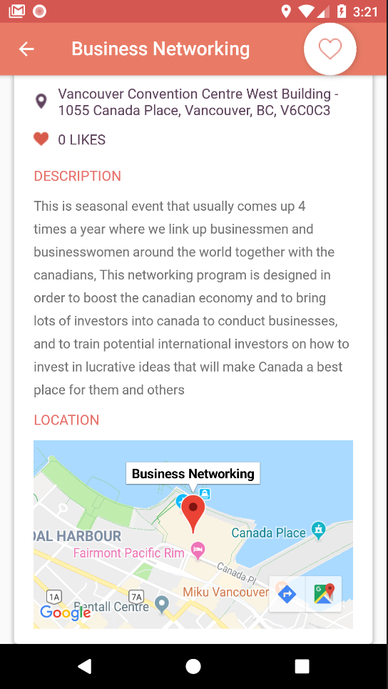
User can like an event
Details information of an event:
Event name
Creator
Date & Time
Location
Number of people liked
Description
teams
features
improve
about
View with Google Map

Slide 5
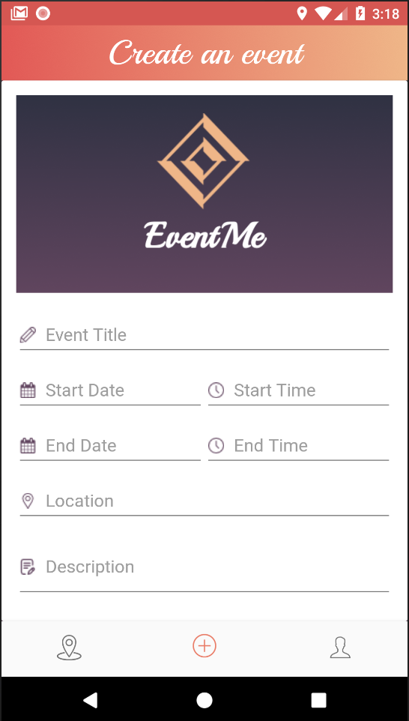
Components
Upload your own event’s image
Dynamic Fragments
Picasso Library
Date picker
Time picker
teams
features
improve
about
Input your event’s information

Slide 6
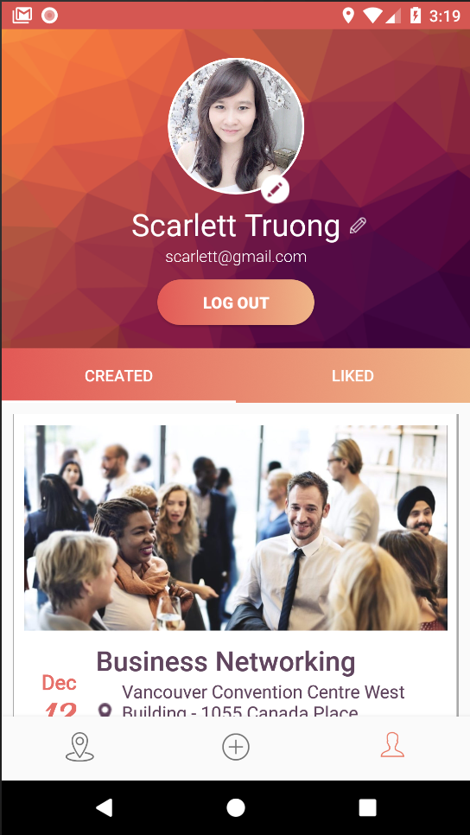
Components
Upload your own profile’s image
Edit your name
Nested Fragments
Tab Layout
Lists View
Picasso Library
View all your created events
teams
features
improve
about
View all your liked events

Slide 7
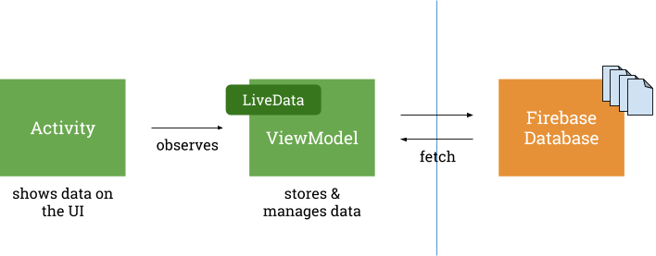
Featured Techniques
Firebase (Authentication, FireStore, Storage)
Google Map & Geocoding
ViewModel & LiveData
teams
features
improve
about

Slide 8

Users can edit or delete created events
Events are categorized
Users can view/follow other users
Advanced search for events
features
teams
improve
about
Notification for new events
Administration features

Slide 9
THANK YOU FOR LISTENING !!!
teams
features
improve
about
TOAN NGUYEN
THAO TRUONG
(Scarlett)
300282895
300284134

